Slide 1

TITLE : Movie Recommendation System Using NLP
TEAM MEMBERS :
Ameen khan (211P025)
Aditya Vishwakarma (211P035)
Mohammed Ahsan Ansari (211P028)
Mohammed Salim Shaikh (211P017)
SUBJECT : Natural Language Processing (NLP)
FACULTY :RAMYA KANAGARAJ

Slide 2
Movie Recommendation System Using Natural Language Processing
Discover a cutting-edge movie recommendation system that leverages the power of Natural Language Processing (NLP) to provide personalized, insightful, and engaging film suggestions tailored to your unique preferences and interests.

Slide 3
Introduction to Recommender Systems
Understanding Recommender Systems
Collaborative Filtering
Content-Based Filtering
This approach uses past user interactions and ratings to make recommendations, identifying patterns and suggesting items similar to those a user has liked before.
This method analyzes the attributes of items (e.g., movie genres, actors, directors) to make recommendations based on a user's preferences and interests.
Recommender systems are algorithms that analyze user preferences and behaviors to suggest content, products, or services that users are likely to enjoy.

Slide 4

Challenges in Traditional Recommender Systems
1
Data Sparsity
2
Cold Start Problem
Limited user data and ratings can make it challenging to generate accurate recommendations.
New users or items have limited data, making it difficult to provide relevant recommendations.
3
Scalability
4
Biased Recommendations
Handling large volumes of users and items can pose computational challenges.
Algorithms can sometimes be biased towards certain items or user preferences.

Slide 5

Natural Language Processing (NLP) Techniques
Text Preprocessing
Sentiment Analysis
Techniques like tokenization, lemmatization, and stopword removal to prepare text data for analysis.
Identifying the emotional tone and sentiment expressed in user reviews and descriptions.
Topic Modeling
Word Embeddings
Discovering the underlying themes and topics within movie-related text data.
Representing words as numerical vectors to capture semantic relationships and similarities.

Slide 6
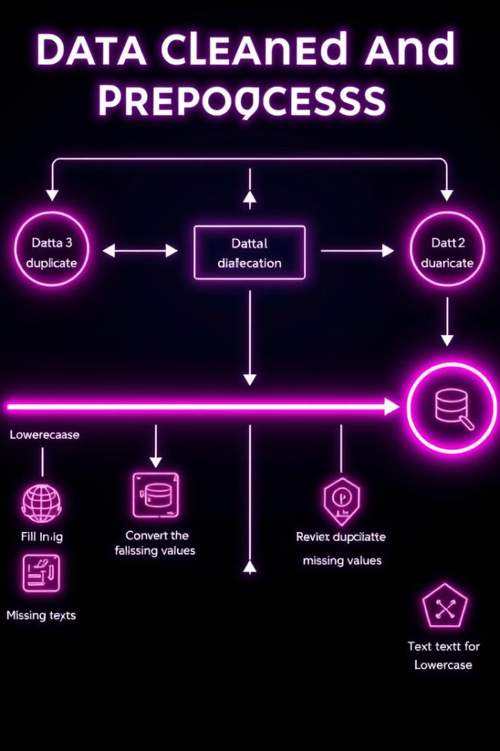




Data Preprocessing and Text Cleaning
Data Collection
Gather relevant text data, such as movie descriptions, reviews, and user comments.
Tokenization
Split the text into individual words or n-grams to prepare for further analysis.
Stop Word Removal
Eliminate common words that don't contribute to the meaning of the text.
Lemmatization
Convert words to their base forms to improve the accuracy of text analysis.

Slide 7





Feature Extraction and Representation
Bag-of-Words
TF-IDF
Represent text as a frequency vector of unique words.
Measure the importance of words based on their frequency and rarity.
Word Embeddings
Topic Modeling
Numerical representations of words that capture semantic relationships.
Discover the underlying themes and topics within the text data.

Slide 8

Sentiment Analysis and Emotion Detection
1
Lexicon-Based
Analyze the sentiment of text by matching words to predefined sentiment dictionaries.
2
Machine Learning
Train models to classify the sentiment of text based on labeled training data.
3
Deep Learning
Leverage neural networks to capture complex patterns and nuances in sentiment expression.

Slide 9
Collaborative Filtering and Content-Based Recommendations
Collaborative Filtering
Content-Based Filtering
Hybrid Approaches
Recommend movies based on similar user preferences and behaviors, identifying patterns in user ratings and interactions.
Suggest movies based on their attributes, such as genres, actors, directors, and plot descriptions, matching user preferences.
Combine collaborative and content-based filtering to leverage the strengths of both methods and provide more accurate recommendations.

Slide 10

Hybrid Recommendation Approaches
1
Weighted Hybrid
2
Cascade Hybrid
3
Feature Combination
Combines collaborative and content-based filtering, with adjustable weights to balance the influence of each approach.
Applies content-based filtering first, then uses collaborative filtering to refine the recommendations.
Merges features from collaborative and content-based models into a single, more comprehensive recommendation algorithm.

Slide 11

Implementation and Deployment Considerations
Scalability
Ensure the system can handle growing user bases and large datasets.
Personalization
Continuously update recommendations based on user feedback and interactions.
Explainability
Provide users with transparent and interpretable reasons for the recommendations.
Deployment
Integrate the recommendation system seamlessly into the existing movie platform or application.

